Slide 1
COURSE NAME : Operating Systems EVEN SEM. 2025-2026
Project Title
Peer-to-Peer File Sharing App

Slide 2
Batch Number- 5
Sec - 1
Submitted by
N.GIRIESHREDDY-2420030125
M.BHARGAV KUMAR -2420030124
G.SANTHOSH -2420030123
P.LOKESH REDDY-2420030128

Slide 3
Problem Statement
Centralized file-sharing systems are prone to bottlenecks, single-point failures, and high resource usage. There is a need for a decentralized, efficient, and reliable file transfer mechanism that enables direct communication among peers.
Objectives:
To build a P2P file-sharing application using TCP/UDP socket programming.
To implement multithreading for concurrent upload and download requests.
To introduce file chunking for efficient large file transfer.
To verify data integrity using checksum validation.
To understand and demonstrate core OS concepts such as concurrency, synchronization, and process communication.

Slide 4
Our Solution – P2P Architecture
Traditional file sharing systems depend on a centralized server to store and distribute files. Our solution eliminates this dependency using a Peer-to-Peer (P2P) architecture, where every peer acts both as a client (requesting files) and as a server (providing files).
How it works:
Each peer runs the same program and is connected through a network using TCP/UDP sockets.
When a peer wants a file, it directly requests it from another peer’s IP and port.
The file is transferred in chunks, ensuring faster and more reliable sharing.
A checksum is computed to verify file integrity after transfer.
Advantages of this approach:
No central dependency → no single point of failure
Scalability → more peers means more sharing capacity
Efficient bandwidth usage
Demonstrates decentralized communication

Slide 5
Technical Deep Dive – The Process
Peer Initialization: Each peer starts by opening a TCP socket and begins listening on a specific port (e.g., 5000).
Connection Setup: When a user wants to download a file, they enter the IP and port of another peer. The requesting peer sends a “GET filename” message.
File Chunking and Transfer:
The sender splits the requested file into smaller chunks (e.g., 1 MB each).
Each chunk is read and sent over the socket sequentially.
The receiver writes these chunks into a new file.
Checksum Validation:
Sender calculates an MD5/SHA-256 checksum for the original file.
Receiver recomputes the checksum for the received file and compares both.
If mismatch → corrupted chunks can be re-requested.
Concurrency Handling:
Multithreading is used so a peer can handle multiple file requests at once.
One thread may upload a file while another downloads from a different peer.

Slide 6
Implementation & Tech Stack
Core Technologies
Software Requirements:
Operating System: Windows / Linux / macOS
Programming Language: Python / Java (with socket and threading support)
IDE: VS Code / IntelliJ IDEA / PyCharm
Hardware Requirements:
Processor: Intel i3 or higher
RAM: Minimum 4 GB
Storage: Minimum 500 MB free space
Network: Local area connection or Wi-Fi

Slide 7
Key Components Built
Component | Description
Peer Node | Core module that allows the program to act as both server and client simultaneously.
Server Handler | Listens for incoming requests from other peers and serves files in chunks.
Client Handler | Connects to another peer to request a specific file.
Thread Manager | Manages multiple threads for concurrent uploads/downloads.
Checksum Module | Handles file integrity verification using hashing algorithms.
Chunk Manager | Divides and reconstructs files efficiently during transfer.
Logger/Console UI | Displays file transfer progress, connected peers, and status messages.

Slide 8
Features Implemented
Direct Peer-to-Peer File Transfer – No central server; all peers communicate directly.
Multithreading Support – Upload and download multiple files at once.
File Chunking – Splits large files into smaller parts for smoother transmission.
Checksum Validation – Ensures data integrity and prevents corruption.
Cross-Platform Compatibility – Works on any OS that supports TCP/UDP sockets.
Simple Command-Line Interface (CLI) – Allows users to send and receive files easily.

Slide 9
Challenges Overcome
Challenge | How It Was Solved
Concurrent Transfers | Used multithreading to manage simultaneous file uploads and downloads without blocking.
Data Corruption During Transfer | Implemented checksum validation to ensure accurate reconstruction of files.
Large File Handling | Added file chunking mechanism for memory-efficient transmission.
Peer Synchronization | Carefully synchronized threads and socket streams to prevent data mix-ups.
Dynamic Peer Discovery (optional challenge) | Initially handled manually, later enhanced with a simple peer list file or tracker concept.
Error Handling & Robustness | Added try-catch blocks and proper socket closing to prevent crashes.

Slide 10
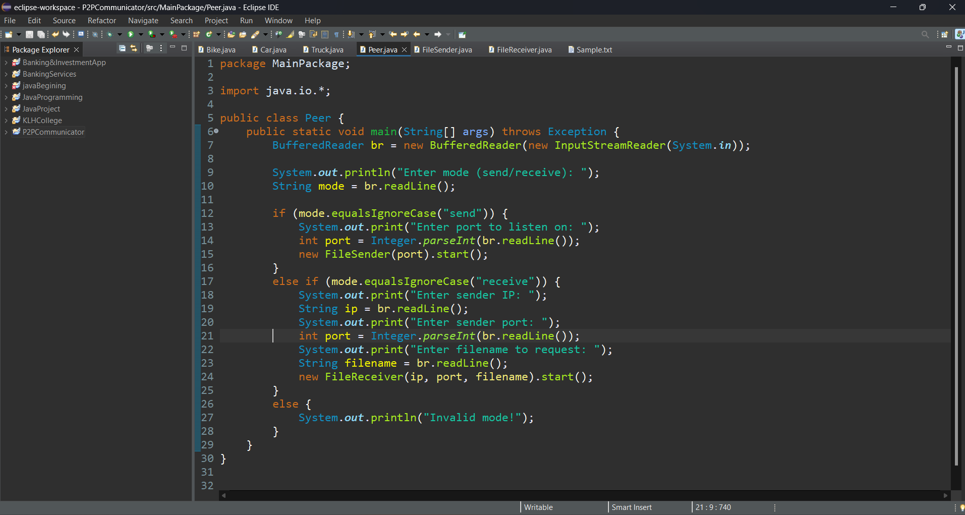
Demo:

Slide 11
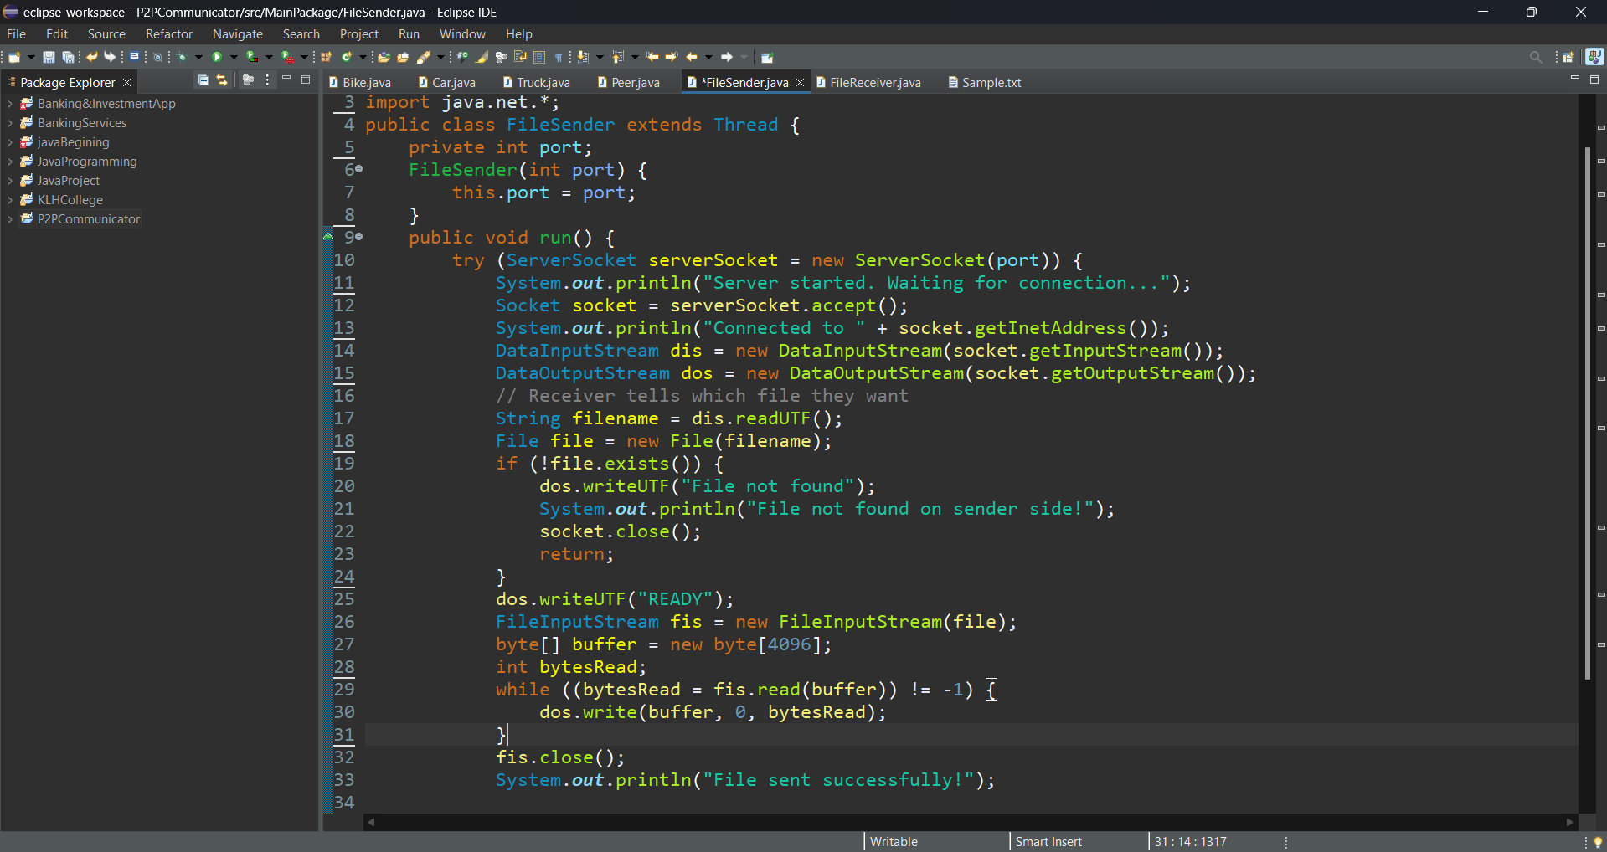
FileSender:

Slide 12
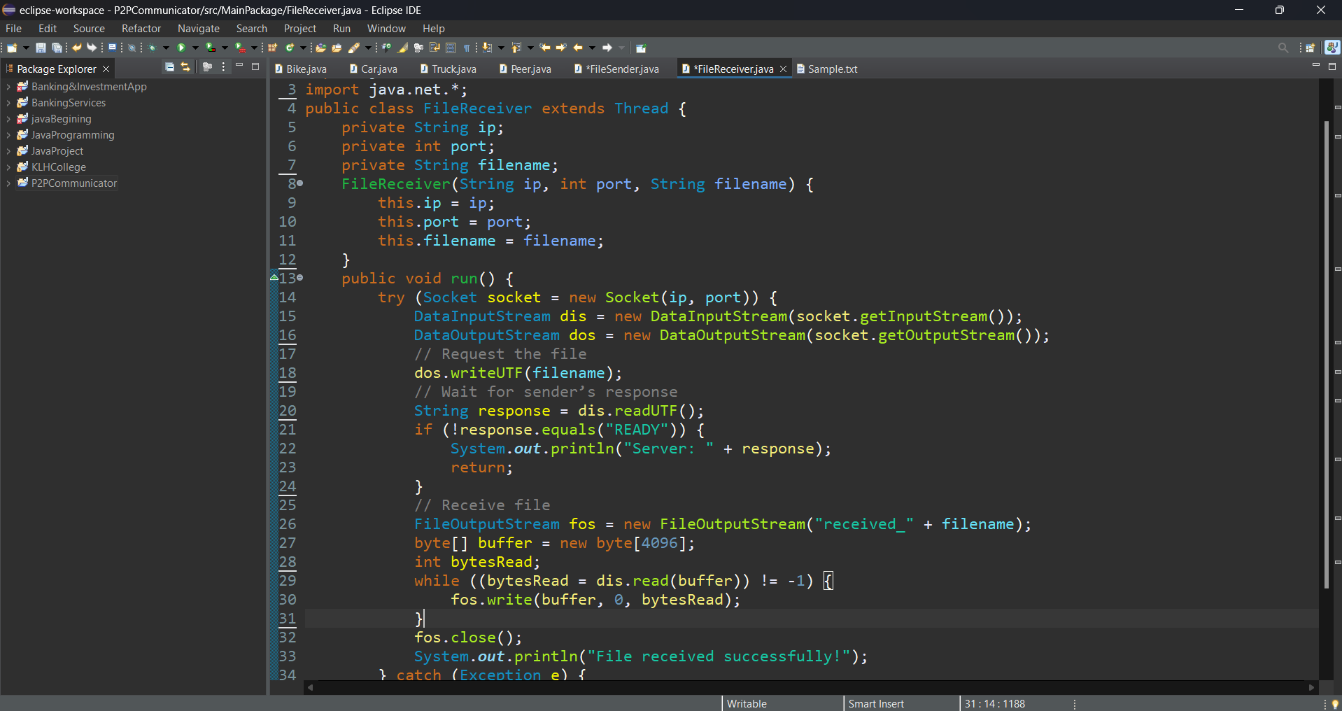
FileReceiver:

Slide 13
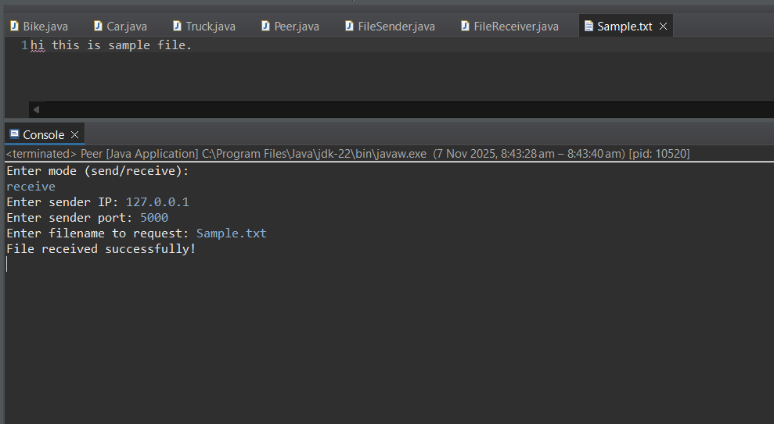
Output Screen:

Slide 14
Future Scope
Implement peer discovery and indexing using a tracker server.
Add encryption for secure data transmission.
Integrate a graphical user interface (GUI) for improved usability and added MultiThreading.
Support parallel downloading of file chunks from multiple peers for higher transfer speed.
Extend the system to support large-scale distributed file sharing.

Slide 15
Conclusion:
The P2P File Sharing App provides a decentralized approach to file distribution, eliminating the need for central servers. It effectively demonstrates networking, concurrency, and synchronization principles in an applied environment. The system achieves efficient data transfer, integrity verification, and parallel communication between multiple peers.

Slide 16

THANK YOU

